Slide 1
2nd Supervisory Board Meeting
Vilnius
October 11th, 2018

Slide 2
Agenda
Summary of the 1st year activities
Research,
Deliverables,
Dissemination & communication,
Events,
Secondments.
Next year activities
Secondments reporting – rules reminder
Dissemination reporting – rules reminder
Website
1st year reporting to coordinator – administrative issues
Next SB meeting – date and venue proposal
AOB

Slide 3
Research
DK

Slide 4
Deliverables
D7.5 Conference calendar - Part 1, ILTSR PAS, M3
D 1.1. Report on solid state synthesis, VU, M6

Slide 5
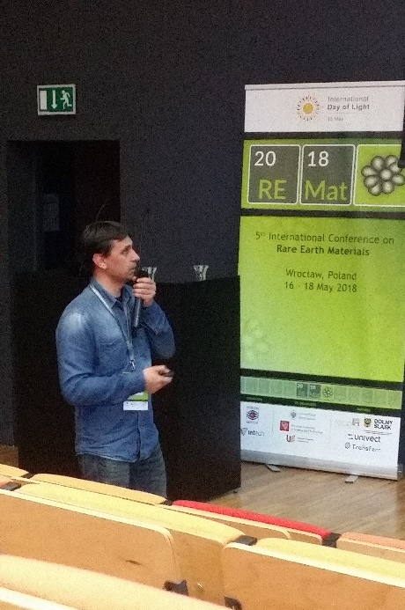
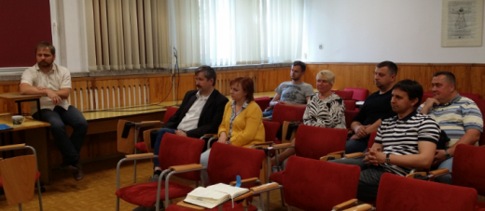
Dissemination & communication
Publications: 8
Invited talks: 2
Dmitry Karpinsky (REMAT’18, Poland),
Aivaras Kareiva (FM&NT-2018, Latvia)
Poster presentations: 16
9 (REMAT’18, Poland),
1 (Electroceramics’18, Belgium)
1 (SPM’18, Russia)
4 (AMT’18, Lithuania)
1 (V UPLMF, Ukraine)
? (OXYGENALIA 2018, Lithuania)
Press / website info / others: 3
Seminars: 1 + …?

Slide 6
TRANSFERR Trainings and Workshops
Organizer | Activity | Period
VU | Training in chemical routes synthesis; dielectric and transport properties measurements. | 2018
FSGSU | Workshop about sol-gel synthesis routes of nanostructures fabrication; | 2018
UA | Workshop for local-scale investigations (AFM, HR-(S)TEM measurements) and Magnetoelectric coupling measurements. | 2019
HZG | Training in structural investigations using synchrotron and neutron scattering techniques (incl. temperature dependent measurements and measurements in magnetic field). | 2019
SPMRC | Teaching of methods and software tools to determine and refine magnetic and crystal structure based on diffraction data. | 2018/ 2019
ILTSR | Training “Your Career Development in Science” (for ESR). | 2020
IoP | Education and training on theoretical methods to study size effects on physical properties of nanoferroics. Tutoring in theoretical modeling of multiferroic properties and vibrational spectroscopy of surfaces and interfaces. | 2019
NC | Trainings in Soft Skills: Project management, Results presentations, IP searching, Product marketing; Training “From Lab to Industry” – How to established Startup company – financial, management and product development aspects. | 2018/ 2019

Slide 7
TRANSFERR Trainings and Workshops
Organizer | Activity | Period
VU | Training in chemical routes synthesis; dielectric and transport properties measurements. | 2018
FSGSU | Workshop about sol-gel synthesis routes of nanostructures fabrication; | 2018
UA | Workshop for local-scale investigations (AFM, HR-(S)TEM measurements) and Magnetoelectric coupling measurements. | 2019
HZG | Training in structural investigations using synchrotron and neutron scattering techniques (incl. temperature dependent measurements and measurements in magnetic field). | 2019
SPMRC | Teaching of methods and software tools to determine and refine magnetic and crystal structure based on diffraction data. | 2018/ 2019
ILTSR | Training “Your Career Development in Science” (for ESR). | 2020
IoP | Education and training on theoretical methods to study size effects on physical properties of nanoferroics. Tutoring in theoretical modeling of multiferroic properties and vibrational spectroscopy of surfaces and interfaces. | 2019
NC | Trainings in Soft Skills: Project management, Results presentations, IP searching, Product marketing; Training “From Lab to Industry” – How to established Startup company – financial, management and product development aspects. | 2018/ 2019

Slide 8
TRANSFERR Conferences
Past
VII Republican Scientific Conference of Students and Graduate Students "Current problems of physics and technology", Gomel, Belarus (FSGSU) - 2018, April 25
REMAT 2018 – 5th International Conference on Rare Earth Materials, Wroclaw, Poland (ILTSR PAS)
Conference "Actual problems of solid state physics", Minsk, Belarus (SPMRC) - 2018, September 24-28
On-going
4th International Conference „OXYGENALIA 2018“, Vilnius, Lithuania, (VU)

Slide 9
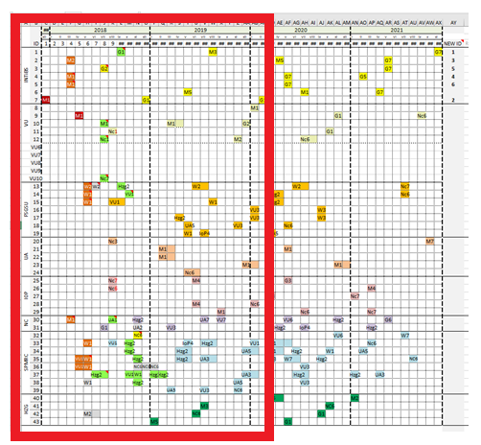
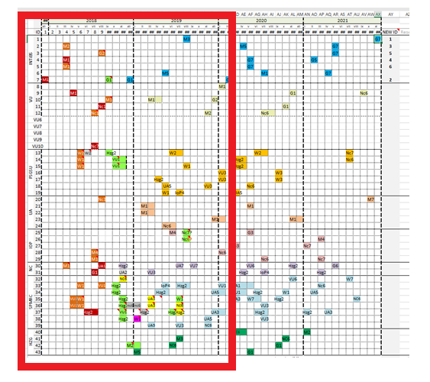
Secondments
Secondments for period 1–11 month
Planned: 36
Performed (or started): 25
after changes

Slide 10
Agenda
Summary of the 1st year activities
Research,
Deliverables,
Dissemination & communication,
Events,
Secondments.
Next year activities
Secondments reporting – rules reminder
Dissemination reporting – rules reminder
Website
1st year reporting to coordinator – administrative issues
Next SB meeting – date and venue proposal
AOB

Slide 11
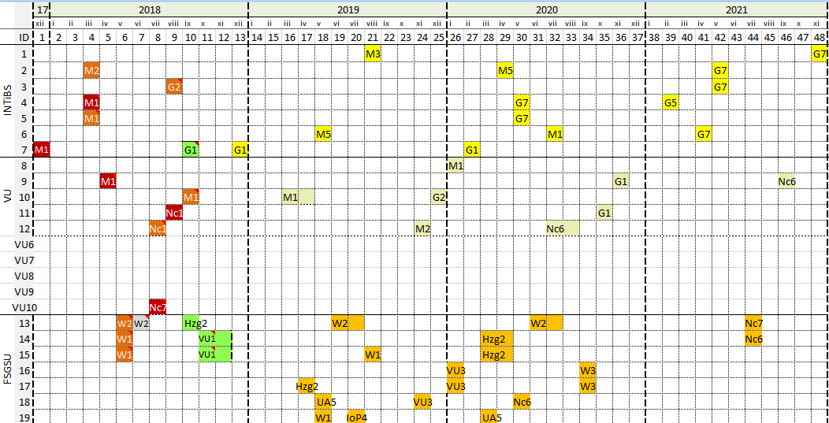
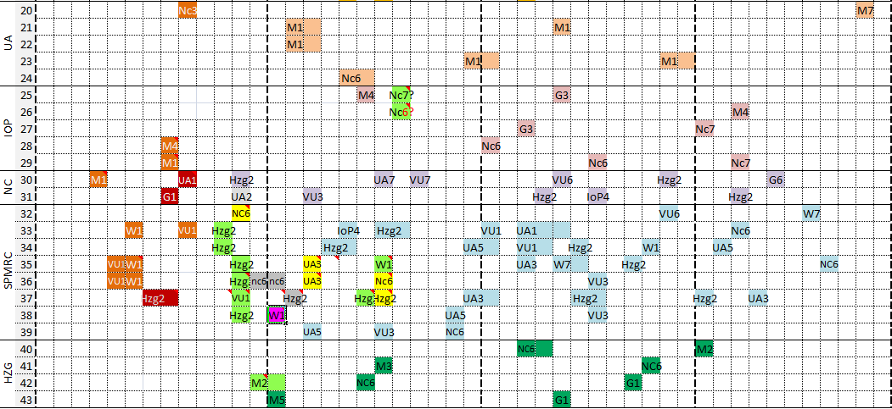

Slide 12
DELIVERABLES
D1.2 Report on synthesis by sol-gel method, VU, M12 (November 2019)
D1.3 Report on phase stability regions, VU, M18 (May 2019)
D8.1 Progress report 1, ILTSR PAS, M12 (May 2019)
D8.2 Mid-term meeting, ILTSR PAS, M18 (November 2019)
CONFERENCES
ESTE 2019, 7th International Conference on Excited States of Transitions Elements (ILTSR PAS) - 2019, September
…?...
GENERAL PUBLIC EVENTS !
SOCIAL MEDIA !
Twitter, Facebook, LinkedIn, Google+, Instagram, Pinterest, YouTube… ?

Slide 13
TRANSFERR Trainings and Workshops
Organizer | Activity | Period
VU | Training in chemical routes synthesis; dielectric and transport properties measurements. | 2018
FSGSU | Workshop about sol-gel synthesis routes of nanostructures fabrication; | 2018
UA | Workshop for local-scale investigations (AFM, HR-(S)TEM measurements) and Magnetoelectric coupling measurements. | 2019
HZG | Training in structural investigations using synchrotron and neutron scattering techniques (incl. temperature dependent measurements and measurements in magnetic field). | 2019
SPMRC | Teaching of methods and software tools to determine and refine magnetic and crystal structure based on diffraction data. | 2018/ 2019
ILTSR | Training “Your Career Development in Science” (for ESR). | 2020
IoP | Education and training on theoretical methods to study size effects on physical properties of nanoferroics. Tutoring in theoretical modeling of multiferroic properties and vibrational spectroscopy of surfaces and interfaces. | 2019
NC | Trainings in Soft Skills: Project management, Results presentations, IP searching, Product marketing; Training “From Lab to Industry” – How to established Startup company – financial, management and product development aspects. | 2018/ 2019

Slide 14
Agenda
Summary of the 1st year activities
Research,
Deliverables,
Dissemination & communication,
Events,
Secondments.
Next year activities
Secondments reporting – rules reminder
Dissemination reporting – rules reminder
Website
1st year reporting to coordinator – administrative issues
Next SB meeting – date and venue proposal
AOB

Slide 15
Secondments reporting
Inform coordinator about your secondment in advance (a few weeks before secondment starts);
After arrival please check if your secondment is on the Participant Portal;
Before leaving get your secondment confirmation from Key Person in the Host intitution;
Keep your tickets and other documents to prove your secondment;
Send a report up to 30 days after finishing of secondmen (even if it is splited);
If the secondment is splited in the period within two months, you can ask coordinator if it’s possible to write one report
Following the brochure (next slide) is the best way to remember the rules.

Slide 16
Brochure

Slide 17
Agenda
Summary of the 1st year activities
Research,
Deliverables,
Dissemination & communication,
Events,
Secondments.
Next year activities
Secondments reporting – rules reminder
Dissemination reporting – rules reminder
Website
1st year reporting to coordinator – administrative issues
Next SB meeting – date and venue proposal
AOB

Slide 18
Dissemination & communication
RULES
About 45 days before submission, the information about the publication being prepared and the manuscript (optional) should be sent to the Dissemination Manager in order to present all partners for discussion and to check confidentiality.
As soon as possible and at the latest on publication, authors must deposit a machine-readable electronic copy of the published version or final peer-reviewed manuscript accepted for publication (postprint) in a repository for scientific publications. (GA chapter 29.2)
To send to the Dissemination Manager the DOI number of the accepted publication, bibliographic information, the deposited version of the work in a repository for scientific publications (preprint or postprint) and other important information, e.g. the status of open access (green, gold), temporary free access.

Slide 19
Agenda
Summary of the 1st year activities
Research,
Deliverables,
Dissemination & communication,
Events,
Secondments.
Next year activities
Secondments reporting – rules reminder
Dissemination reporting – rules reminder
Website
1st year reporting to coordinator – administrative issues
Next SB meeting – date and venue proposal
AOB

Slide 20
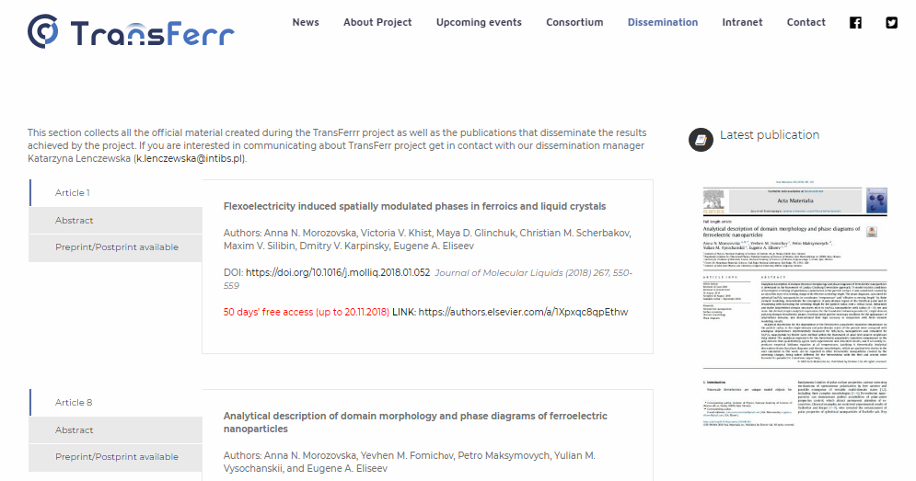
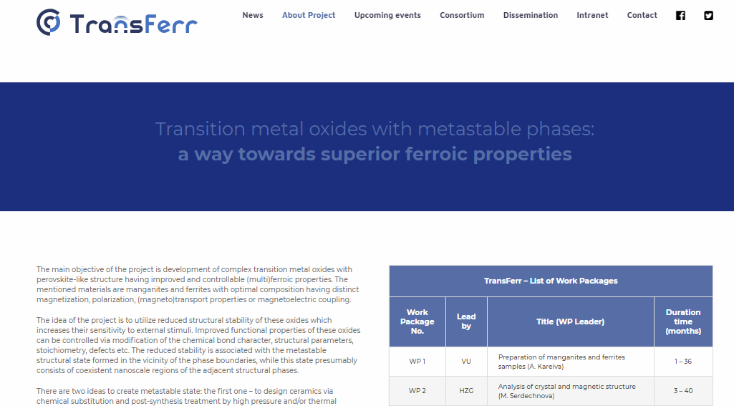
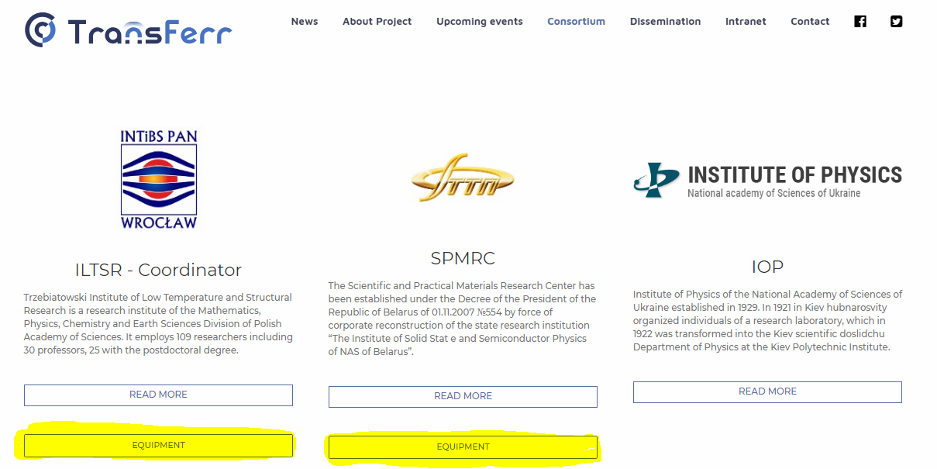

Slide 21
Agenda
Summary of the 1st year activities
Research,
Deliverables,
Dissemination & communication,
Events,
Secondments.
Next year activities
Secondments reporting – rules reminder
Dissemination reporting – rules reminder
Website
1st year reporting to coordinator – administrative issues
Next SB meeting – date and venue proposal
AOB

Slide 22
To be reported to Coordinator
What:
Research
Activities (Articles / presentations / seminars / lectures etc.)
Secondment changes planned in 2019
Financial issues
Risks
When:
End of December ?

Slide 23
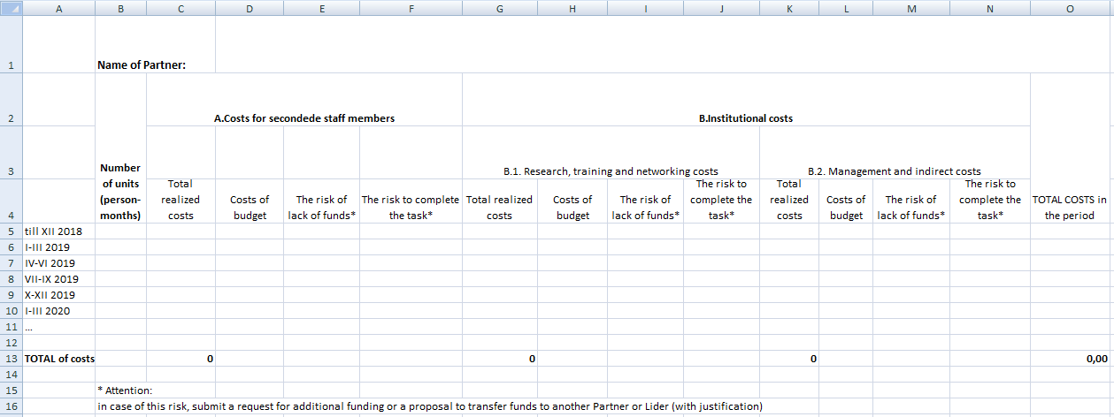
Financial report

Slide 24
Agenda
Summary of the 1st year activities
Research,
Deliverables,
Dissemination & communication,
Events,
Secondments.
Next year activities
Secondments reporting – rules reminder
Dissemination reporting – rules reminder
Website
1st year reporting to coordinator – administrative issues
Next SB meeting – date and venue proposal
AOB

Slide 25
Next SB meeting
D8.2 Mid-term meeting, ILTSR PAS, M18
May 2019
When ..?..
Where ..?..

Slide 26
Others
Risks – ?
Presentations’ template – ?
AOB – ?

